Slide 1
Manufacturing Simulation

Slide 2
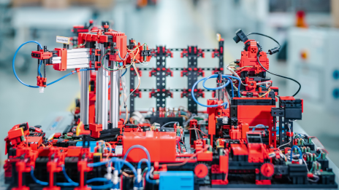
Learning Factory
Overview
Operate
Neuronal network
Monitor

Slide 3
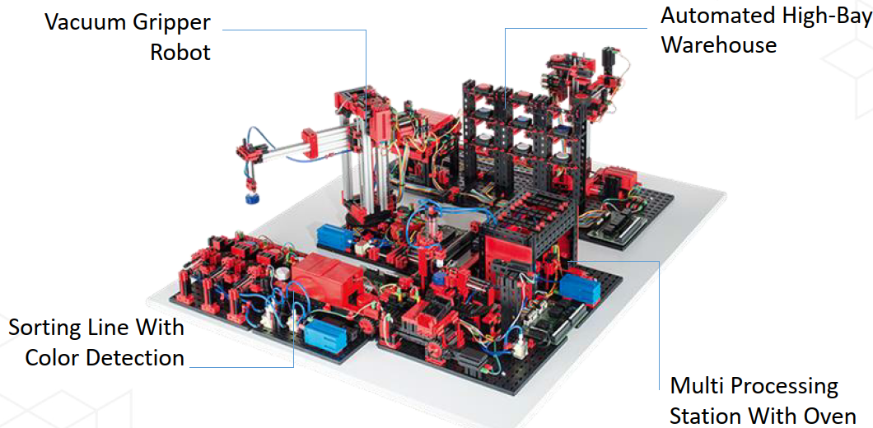
Overview model

Slide 4
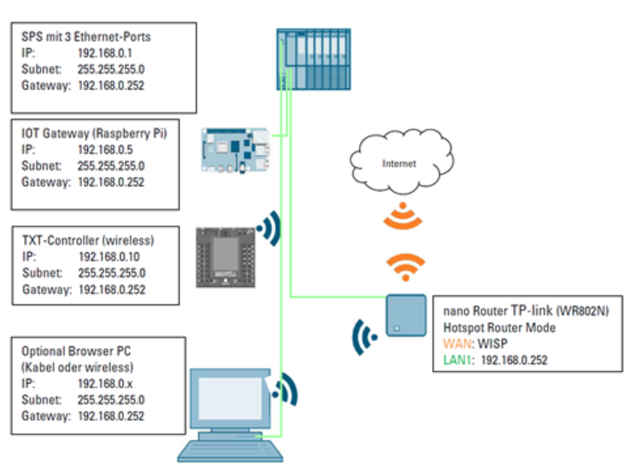
1. Communication with model

Slide 5
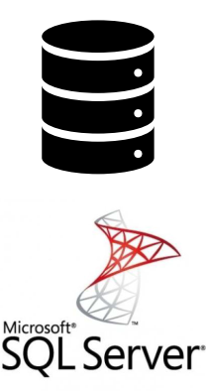
2. Data collection
Read sensors
State of actuators
→Transmit data into database

Slide 6
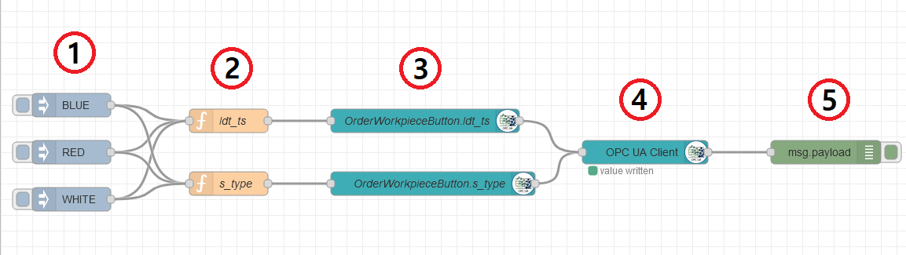
3. Control simulation
Software
Control with python
Contol with RED-Note
What to achieve:
Purchase material
Ask for status of parts from the simulation
Initialize steps of simulation

Slide 7
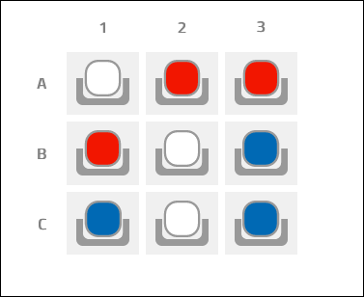
4. Analyse Data
Make data IoT ready

Slide 8
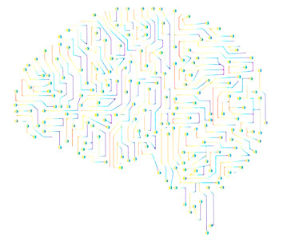
5. Neuronal Network
Create
Train
Run

Slide 9


Terima kasih

